Slide 1
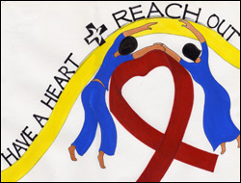
2011—AROUND THE WORLD
Logo from Malaysia, courtesy of Church World Service
Copyright: Center for the Church and Global AIDS

Slide 2
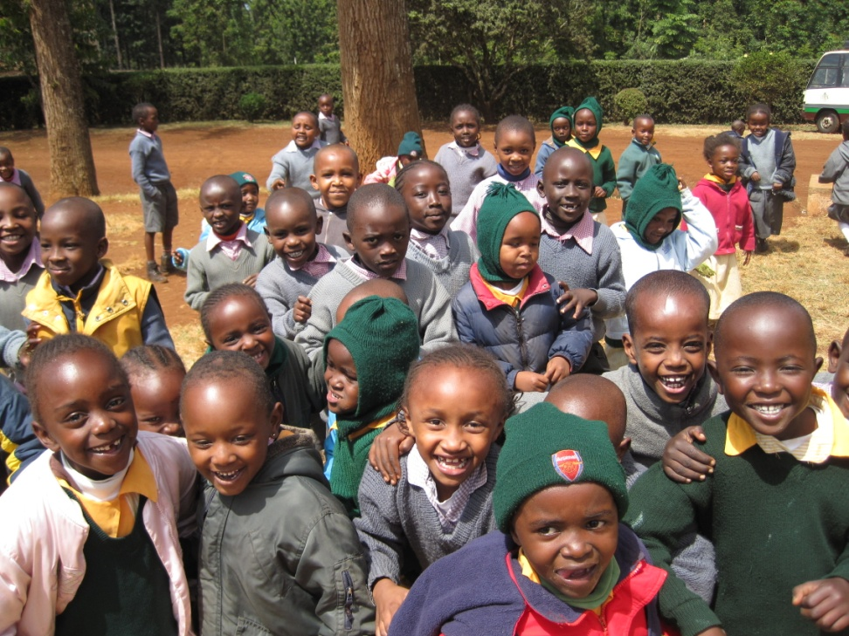
Staggering HIV & AIDS Statistics
34 million people infected world-wide; almost 50% women
In the USA, 1.2 million infected; 25% do not know they are infected
Over 15 million orphans
No cure or vaccine
Kenya Methodists in Meru Seek to Help 1200 AIDS orphans

Slide 3

On Valentine’s Day
All of us on like to be reminded we are loved . . .
But do we really need yet another box of candy or bouquet of flowers?
Or can we also give an alternative gift of “love and life to an AIDS orphan”, as proposed by Bishop Elaine J. W. Stanovsky?

Slide 4
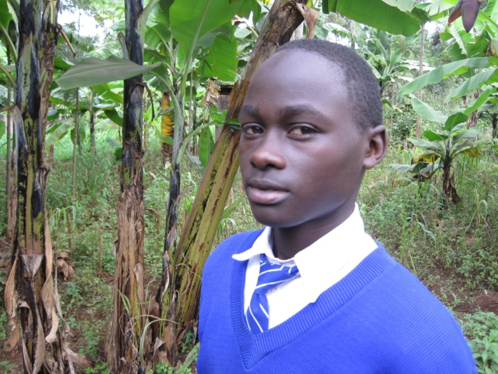
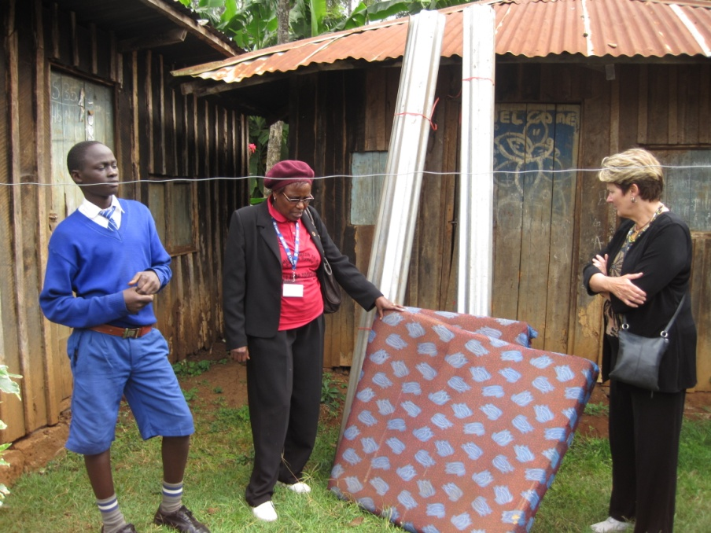
Money Given Goes To Kenya
Your Valentine’s gift helps people like 13 year-old Wilfred
Both his parents & a younger sister died of AIDS.
Now alone Wilfred cares for his little sister
But thanks to the Methodist AIDS ministry, he writes they “brought us a mattress, blankets, iron roofing, school uniforms, and mosquito nets.”
Wilfred with UM AIDS Director Florence Murugu & Colorado visitor

Slide 5
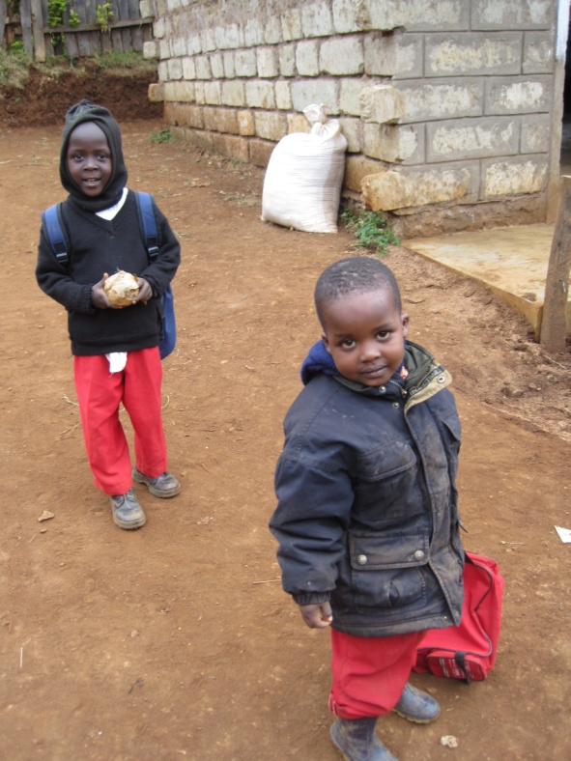

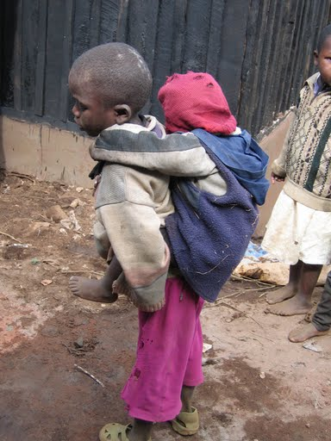
United Methodist Global AIDS Fund
Partners with the Methodist Church of Kenya and others
The Fund has made 175 grants in 37 countries
This Valentine’s Day “have a heart” and join to help “the least of these”
“Bear one another’s burdens, and in this way you will fulfill the law of Christ.” Gal. 6:2

Slide 6


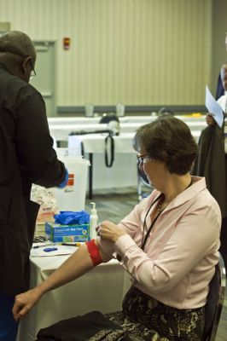
Thank You For Your Gift
UMCOR Advance
# 982345
“If your heart is as my heart, let us join hands in this cause.”
Bishop Elaine J. W. Stanovsky
(Pictured to the right being publicly tested for HIV with other United Methodist bishops.)

